Slide 1
USER STORY 454637 Automate cleanup of old transaction data to get rid of space issue in dev environment

Slide 2
Overview
Sandbox memory : (Max) – storage space in env
Threshold value : {75%(Max)} - configurable
Remaining memory: x mb { calculated dynamically} – unused memory
Memory in use(objects) : (Max – x) mb – memory used by objects
Check_Available_Space (scheduler class)
If (Memory in use > Threshold value)
then call Clean_Old_Transaction_Data (batch class)

Slide 3
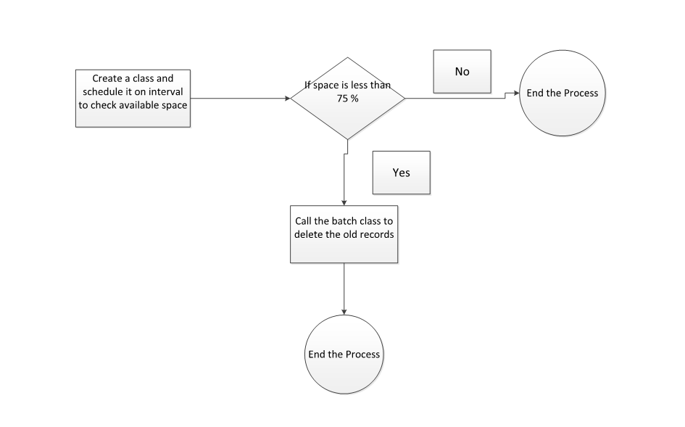
Flowchart
Is space more than 75%?

Slide 4
Components
Check_Available_Space - This class (scheduled at regular interval) will calculate the threshold value, measure the storage space used by the objects and call the batch class if storage space used by objects is greater than threshold value.
Clean_Old_Transaction_Data - Deletes the old transactional data for certain time range.

Slide 5
Custom Settings
BatchSize
Cleanup_Data_Number_of _Days
Object_Name
Email_sent_to_Environment_team
TimeInterval
SenderEmail
thresholdValue

